Slide 1

Independent. Innovative. And always open source.
dotnetfoundation.org

Slide 2
.NET User Groups Townhall
April 20th 2022
Please fill out attendance form:
https://forms.office.com/r/9WRtjyaaXk

Slide 3
Agenda
Meet the sub-committee team
New updated .NET 6 content
State of .NET User Groups
Discussion

Slide 4

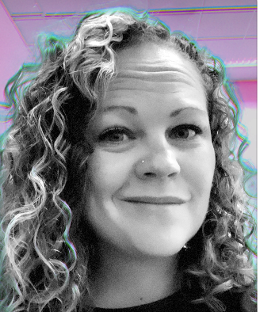



We are here to help!
Jayme Singleton
Nicole Miller
Aneesh Lal Gopalakrishnan
Jon Galloway
James Montemagno

Slide 5
Let’s start talking more
This will be a quarterly call!
E-mail us: usergroups@dotnetfoundation.org
Chat with us and other UG organizers:
Were do you want to chat with us?
Discord
A new discord server (.NET Foundation?)
C# discord server?
.NET discord server?
Somewhere else?
Leave some comments in the chat

Slide 6
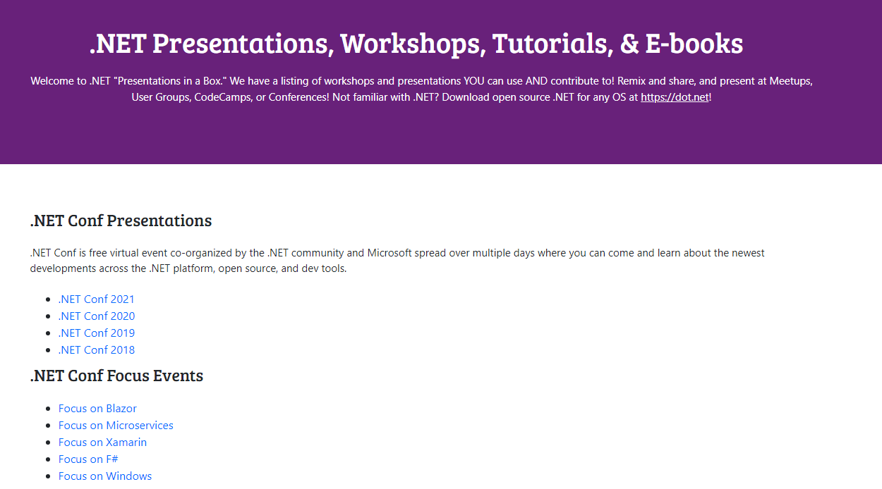
New .NET Content
https://dotnetfoundation.org/community/resources

Slide 7
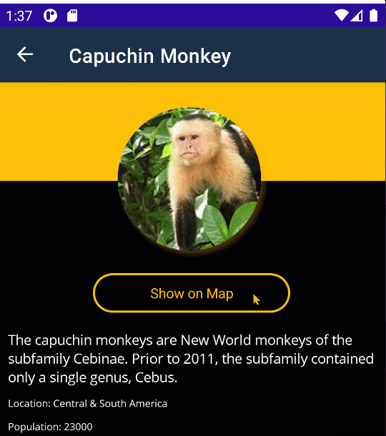
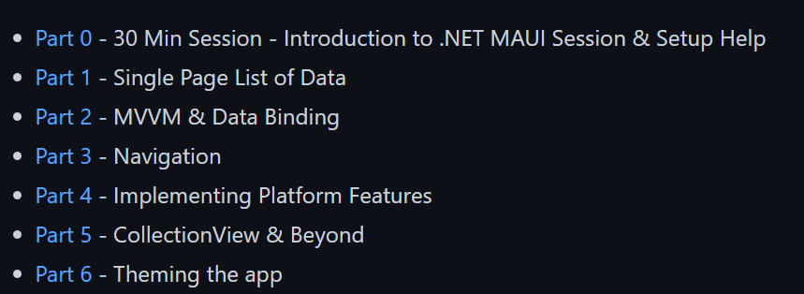
NEW: .NET MAUI Workshop
github.com/dotnet-presentations/dotnet-maui-workshop
6 Part Series
Slides
Video Recording (soon)

Slide 8
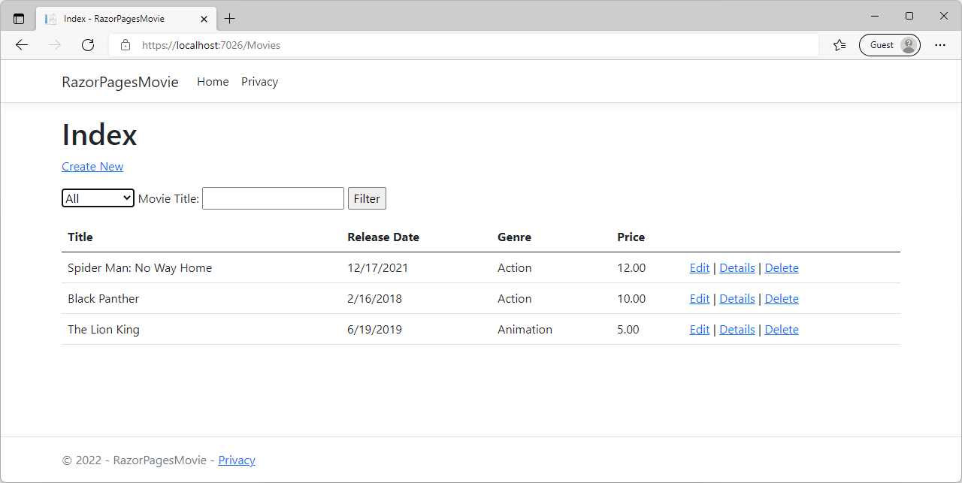
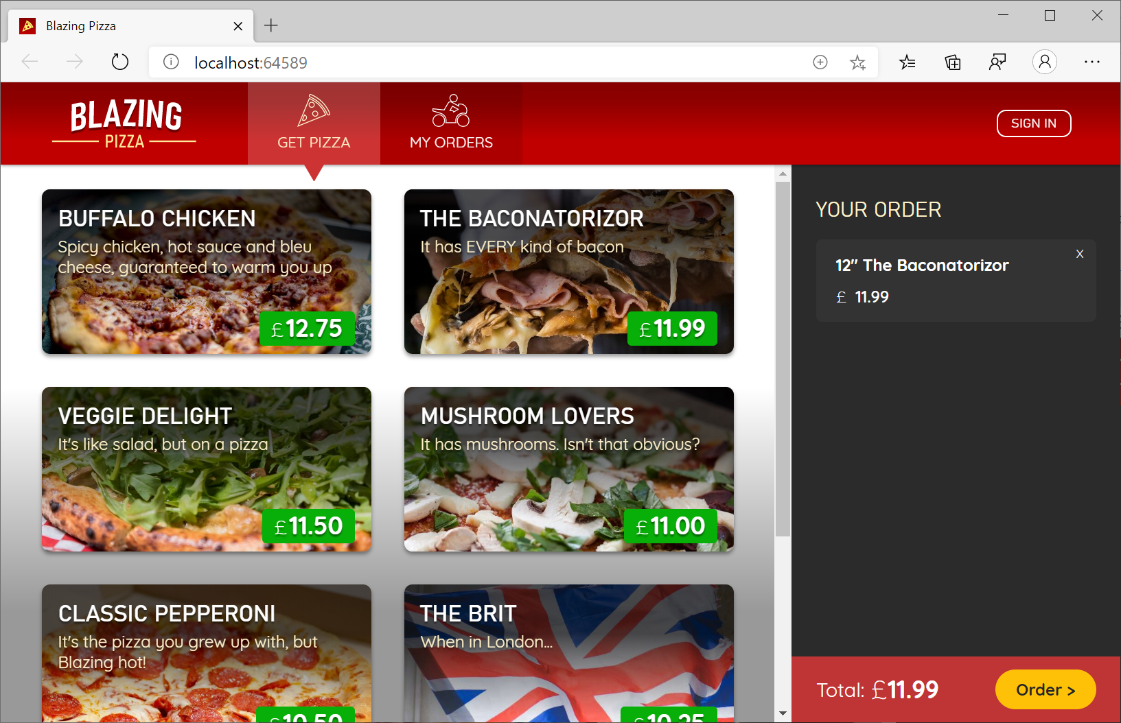
Updated Workshop
C# 9 & 10 Workshop
https://github.com/dotnet-presentations/csharp-workshop
ASP.NET Core for Beginners
https://github.com/dotnet-presentations/aspnetcore-for-beginners
Blazor Workshop
https://github.com/dotnet-presentations/blazor-workshop/

Slide 9
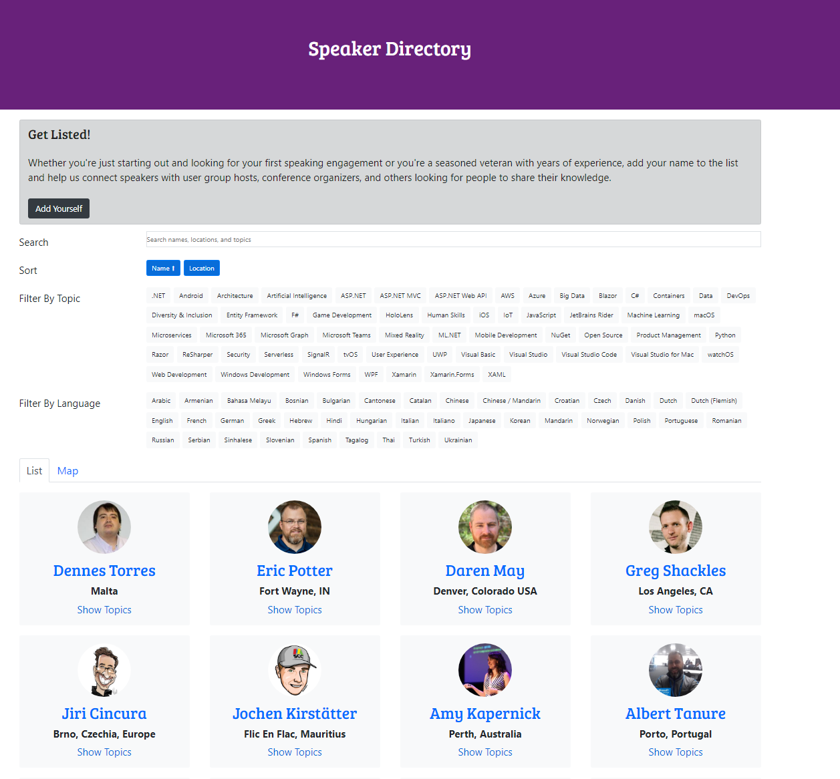
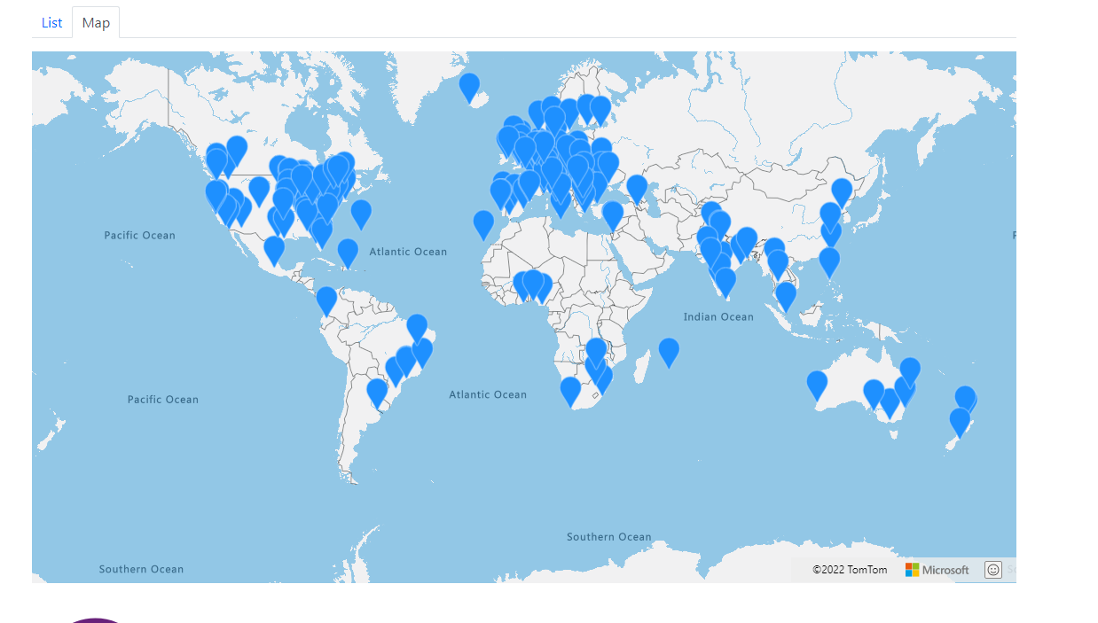
Speaker Directory
https://dotnetfoundation.org/community/speakers

Slide 10
State of .NET User Groups

Slide 11
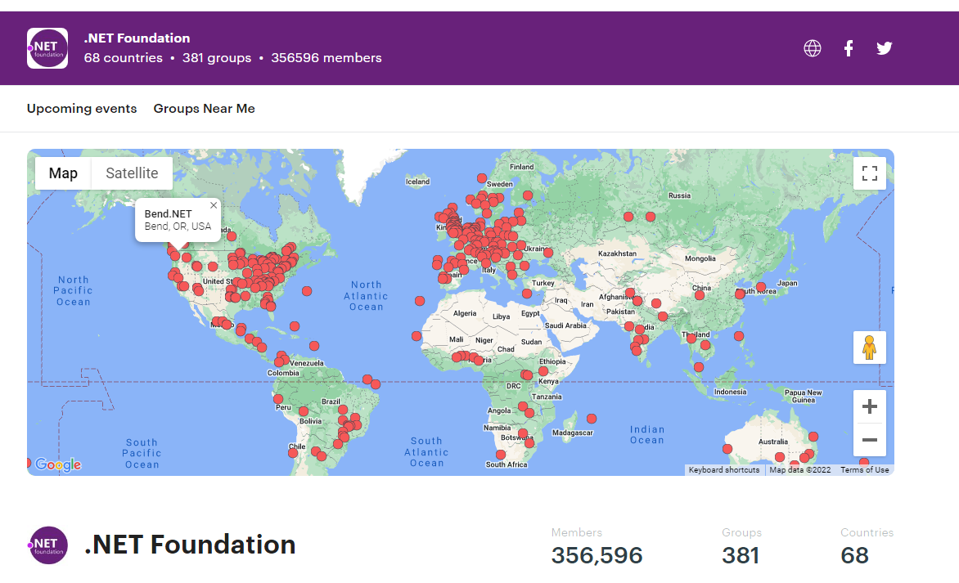
Where User Groups are Today
Meetup
meetup.com/pro/dotnet
Eventbrite
Facebook/YT/LinkedIn
Independent Sites
Plan: Create major directory of all user groups on foundation site.

Slide 12
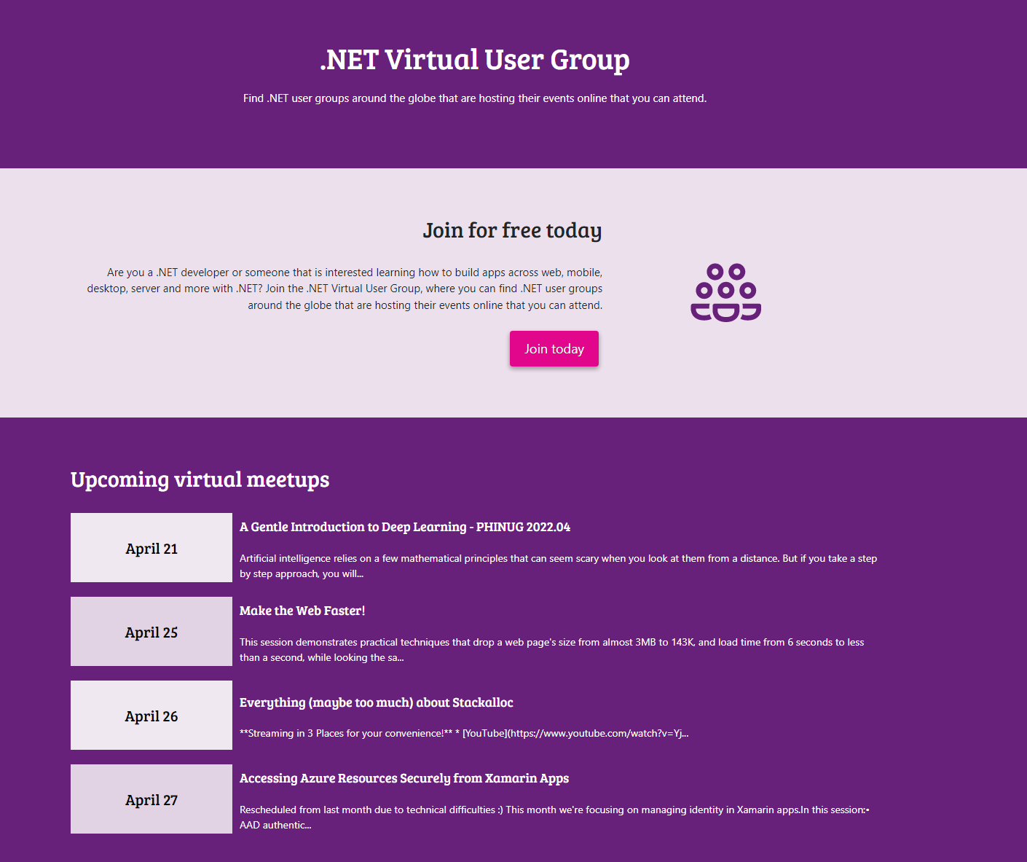
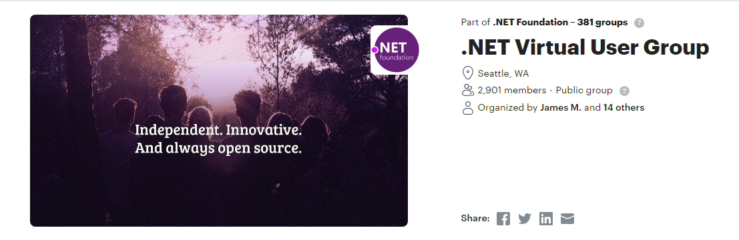
Virtual User Group
https://dotnetfoundation.org/community/virtual-user-group
2 Parts
Meetup (promote virtual events)
StreamYard support
Stream to YT, Twitch, LinkedIn
Please use & promote!

Slide 13
Meetup Pro
Fiscal Responsibility

Slide 14
Meetup Pro – 381 Groups | 356K Members
What is provides user groups
.NET Foundation covers the cost of meetup.com
Discoverability through meetup pro account
Additional contact tools for organizers
What is costs the .NET Foundation
Just about $200 per group, per year (billed quarterly)
$75,415.81 per year

Slide 15
State of Meetup Pro Groups
381 Groups
130 Groups last meeting was in 2022 (most active schedule)
91 Groups last meeting was in 2021 (17 active schedule)
72 Groups last meeting was in 2020 (1 group active schedule)
45 Groups last meeting was in 2019 (1 group active schedule)
31 Groups last met in 2018/17/16
12 Groups have never met & no scheduled events (most were formed in 2018/19/20)

Slide 16
User Group Health Plan Proposal
Goal:
Create a plan to support & grow active user groups on Meetup Pro
Invest $ into more user group initiatives (meetup, swag, food, etc)
Removing inactive user groups from Meetup Pro account
Example: 76 inactive user groups would save $13,680 a year
We are going to be OVERLY CAUTIOUS on removing any groups

Slide 17
User Group Health Plan Proposal
Initial Plan:
Contact all Meetup Pro user groups that have not met in 2+ Years
Meetup, MailChimp, and social emails.
Timeline: 6 Months to re-activate the group
Find new organizers or schedule meetup (virtual or physical)
OR reach out and ask for more time
Notice 1 month before removal to double check
User Group is removed from Meetup Pro account
Can ALWAYS re-apply for Meetup Pro account

Slide 18
Submitted Questions

Slide 19
Submitted Questions
Hi, any suggestions to get sponsors or otherwise financial assistance with running a user group?
Due to the pandemic, we've had online sessions and attracted people from further away to take part in our meetup. How would you deal with that discrepancy past lockdown? Stay online, become in person again and loose those folks or is there some form of hybrid mode that you have experience with?

Slide 20
Submitted Questions
Is it possible to re-build INETA to support speakers, swag, participation in regional conferences ? It's easier to talk about multithreading than chase sponsors.
Right now it seems it's easier to find .NET talks at Java conferences like Voxxed (I'm in the Voxxed Athens prog committee https://voxxeddays.com/athens/). Is it possible to start a similar program for .NET, or cooperate with existing regional conferences?
MS subsidiaries abandoned .NET to push Azure subscriptions aggressively (or worse, trying to force Azure on meetups and confs) for the last 7+ years. I haven't seen a DevDays in Greece for almost 10 years. This created the impression that both .NET and Azure are seriously uncool and only meant for the backoffice, a subscription cost to be reduced. At the same time, JavaScript meetups pre-covid had 200 attendees. The next Ministry-of-Testing meetup in Athens will have ~500 - a meetup, not a conference https://motathens.gr/. How can we reverse this, when it seems we have to convince Microsoft itself that .NET is worth it? I want talks about Channels, .NET Core on Linux and Mac, not another "WordPress on Azure". It's hard to push for .NET slots in Voxxed Athens when MS itself is either absent or interested in pushing Azure

Slide 21
Discussion (Comment section on YouTube)
User Group Health Proposal Plan
What support do you need?
Other Topics
E-mail us: usergroups@dotnetfoundation.org

